Slide 1
New Updates to the Report Card for the Carmel River Watershed
Created by Erika Garig

Slide 2
New way to Give the Entire watershed a grade
Overall Carmel River Watershed Grade Table
EEAs | Overall Condition for Each Category | Total Grade of Carmel River Watershed
Chemical & Physical | 79 | 67
Biotic & Ecological | 66
Landscape | 82
Natural Disturbance | 29
Notes:
Explain that Chemical & Physical along with Biotic & Ecological weigh 2 while Landscape and Natural Disturbance weigh 1 because of both more indicators and importance level in those the first two categories

Slide 3
New way to Give the Entire watershed a grade
Total = (((1/3(Chemical & Physical)) + (1/3(Biotic & Ecological)) + (1/6(Landscape)) + (1/6(Natural Disturbance))) * 100
Notes:
Explain that Chemical & Physical along with Biotic & Ecological weigh 2 while Landscape and Natural Disturbance weigh 1 because of both more indicators and importance level in those the first two categories

Slide 4
New way to Give the Entire watershed a grade
Overall Carmel River Watershed Grade Table
EEAs | Overall Condition for Each Category | Total Grade of Carmel River Watershed
Chemical & Physical | 79 | 67
Biotic & Ecological | 66
Landscape | 82
Natural Disturbance | 29
Notes:
Explain that Chemical & Physical along with Biotic & Ecological weigh 2 while Landscape and Natural Disturbance weigh 1 because of both more indicators and importance level in those the first two categories

Slide 5
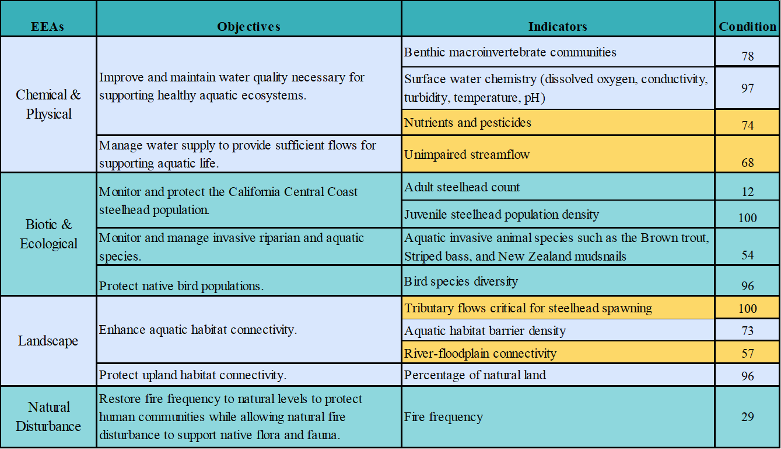
New Indicator/ Current Updates
Notes:
Just added the Nutrients and Pesticides indicator which has a score of 74, on the next slide we will go into more detail on how this was calculated. The tributary flows indicator is being currently updated by Erika to be based on environmental flows (eflows) which will be combined with Unimpaired Streamflow. Courtney is working on River-floodplain connectivity indicator. Both of them just started working on this update so hopefully will be done by end of December for these updates.

Slide 6
Pesticides and Nutrients
Used Ceden data from 2000-2020
Calculated score by comparing observations to EPA limits or Minimum Detection Limit (MDL)
Grouped into old 2000-2010 and new 2011-2020 observations
Nutrients reported for Carmel above (upper) and below (lower) Schulte rd. Pesticides were only recorded in lower Carmel.

Slide 7
How the Pesticides and Nutrients indicator was calculated
Used Ceden data from 2000-2020 for both nutrients and pesticides data
Calculated using the MEQ scoring system by having the thresholds either set by the EPA or by the Minimum Detection Limit (MDL)
Grouped into old versus new for both pesticides and nutrients old being 2000-2010 and new 2011-2020.
Nutrients were grouped by lower and upper Carmel which was at Schulte rd. Anything above Schulte rd. was upper and anything below was lower Carmel. Pesticides were only recorded in lower Carmel.
Also put Sulfate and Chloride together because their threshold (250 mg/L) was much higher than the rest of the nutrients
Separated Phosphorus because it had a very low threshold (0.055 mg/L) compared to the other nutrients

Slide 8
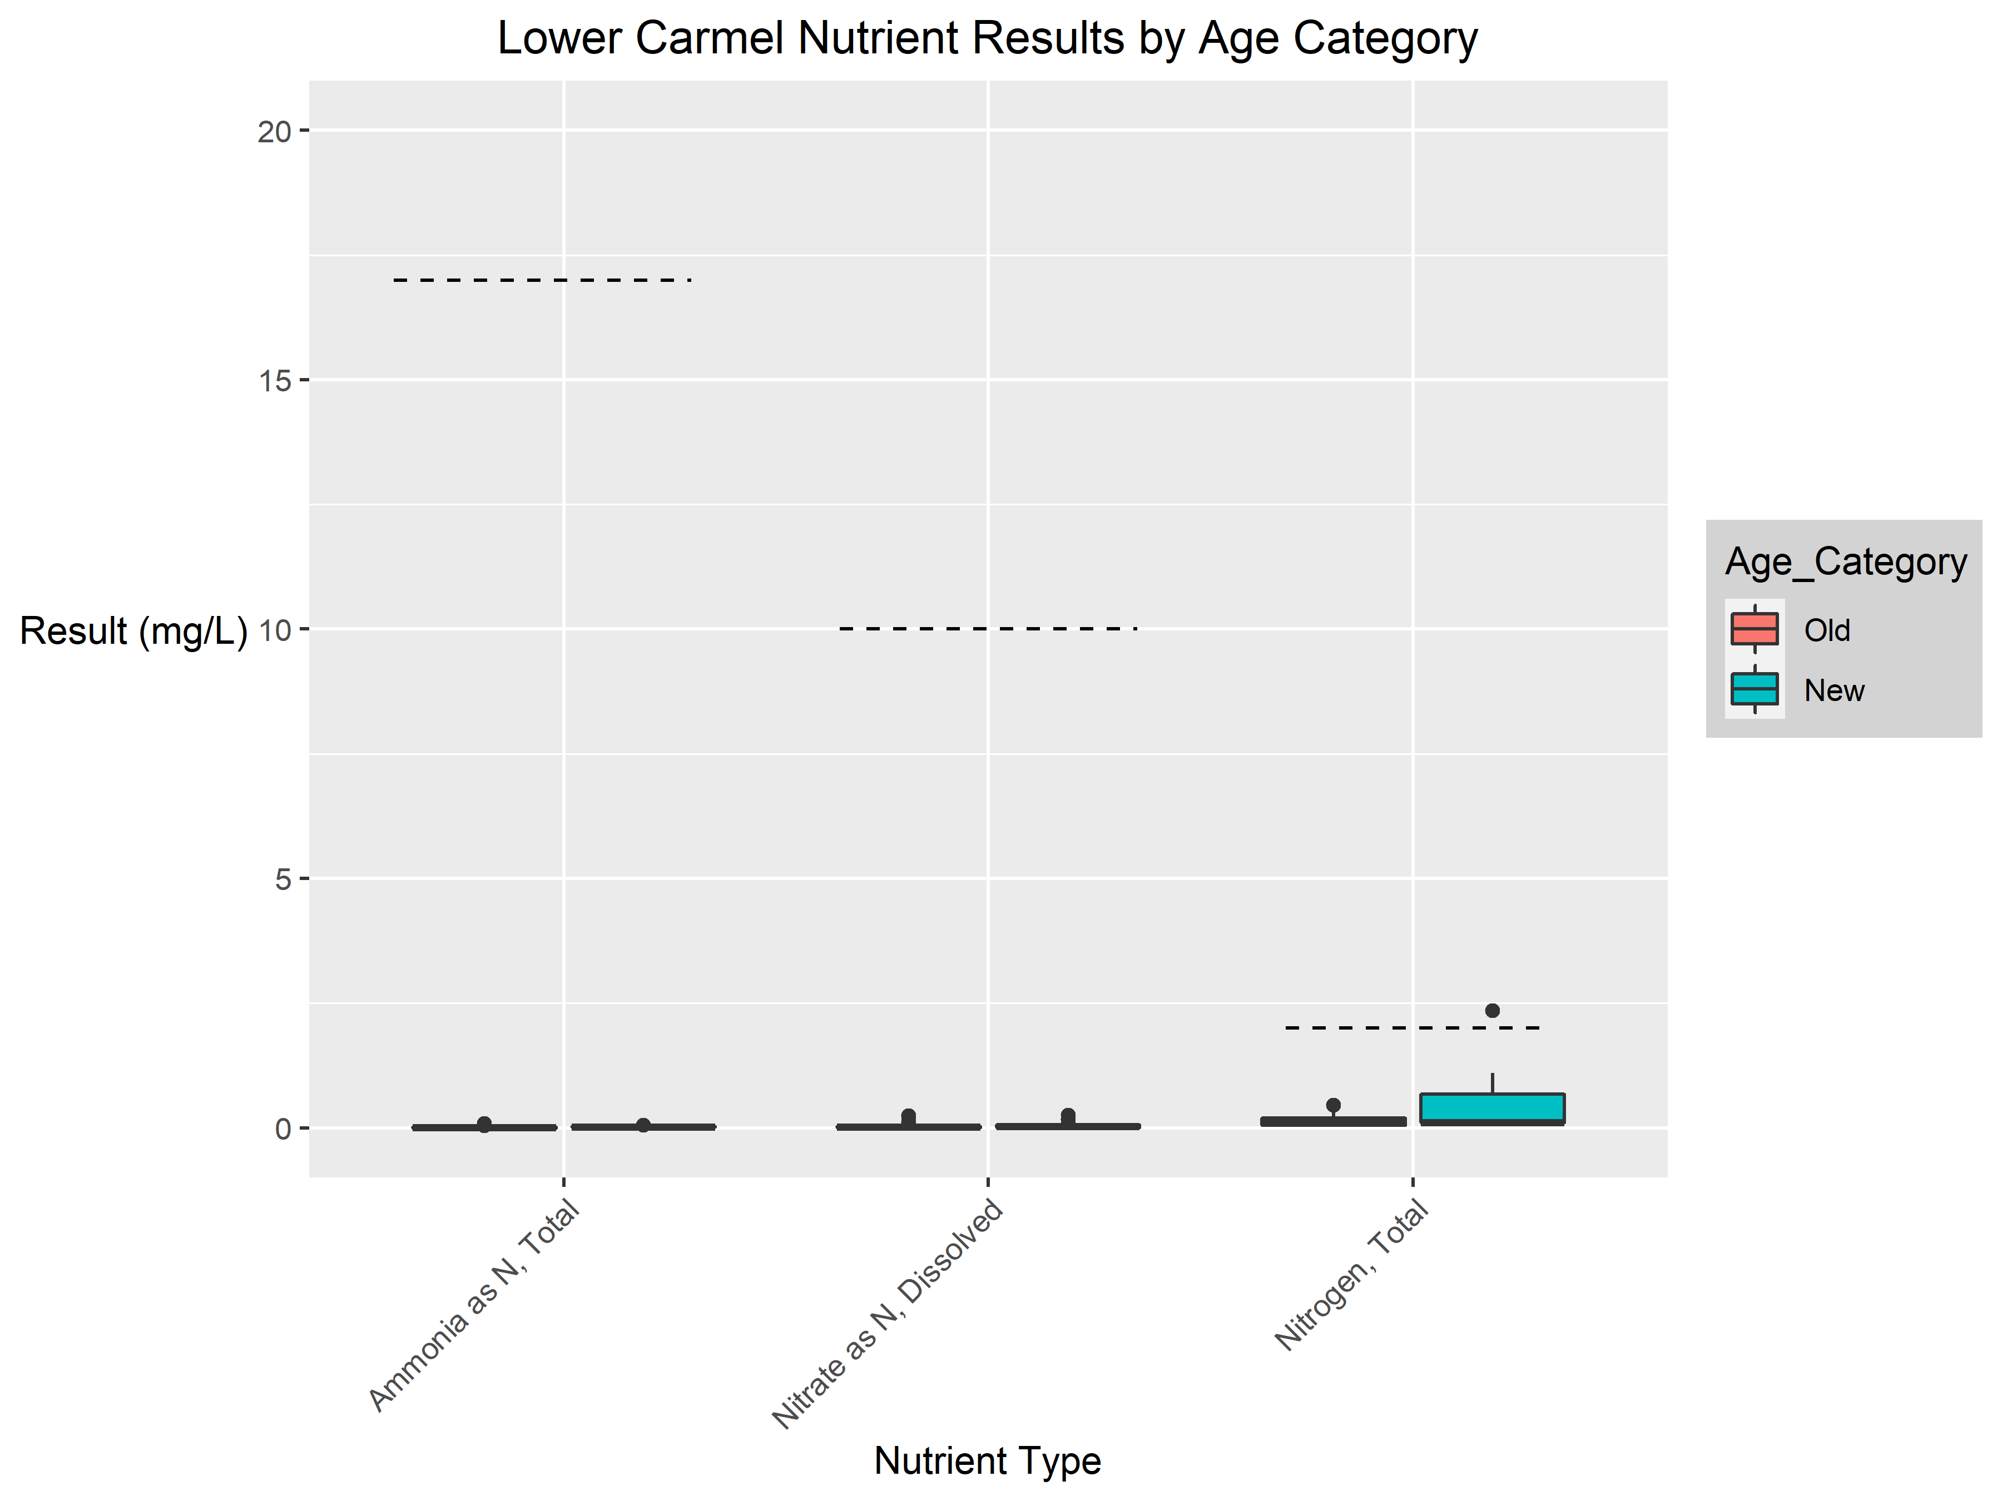
Lower Carmel Nutrient Graphs
250
200
150
100
50
0
20
17 mg/L
15
Result (mg/L)
10 mg/L
10
5
2 mg/L
0
Chloride, Chloride, Sulfate,
Dissolved Total Dissolved
Ammonia Nitrate Total Nitrogen
Notes:
Sulfate and Chloride threshold 250mg/L, Ammonia 17 mg/L, Nitrate 10 mg/L, Nitrogen 2 mg/L, note that the scales on both graphs are different 0-250 first graph, 0-20 second graph

Slide 9
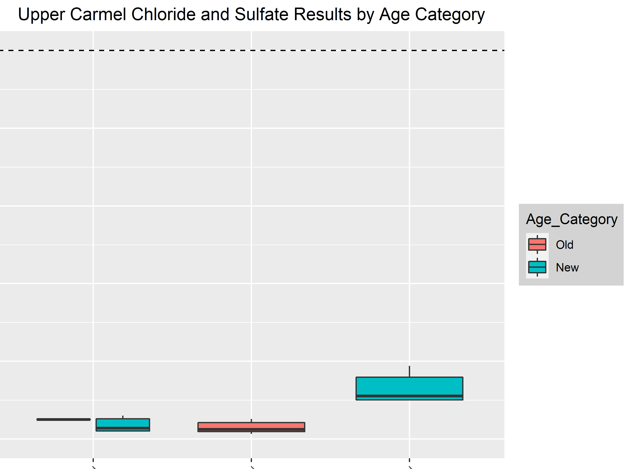
Upper Carmel Nutrient Graphs
250
20
17 mg/L
200
15
150
Result (mg/L)
10 mg/L
10
100
50
5
2 mg/L
0
0
Chloride, Chloride, Sulfate,
Dissolved Total Dissolved
Ammonia Nitrate Total Nitrogen
Notes:
Chloride Total is only seen in the older data in the upper Carmel portion, note that the scales on both graphs are different 0-250 first graph, 0-20 second graph

Slide 10
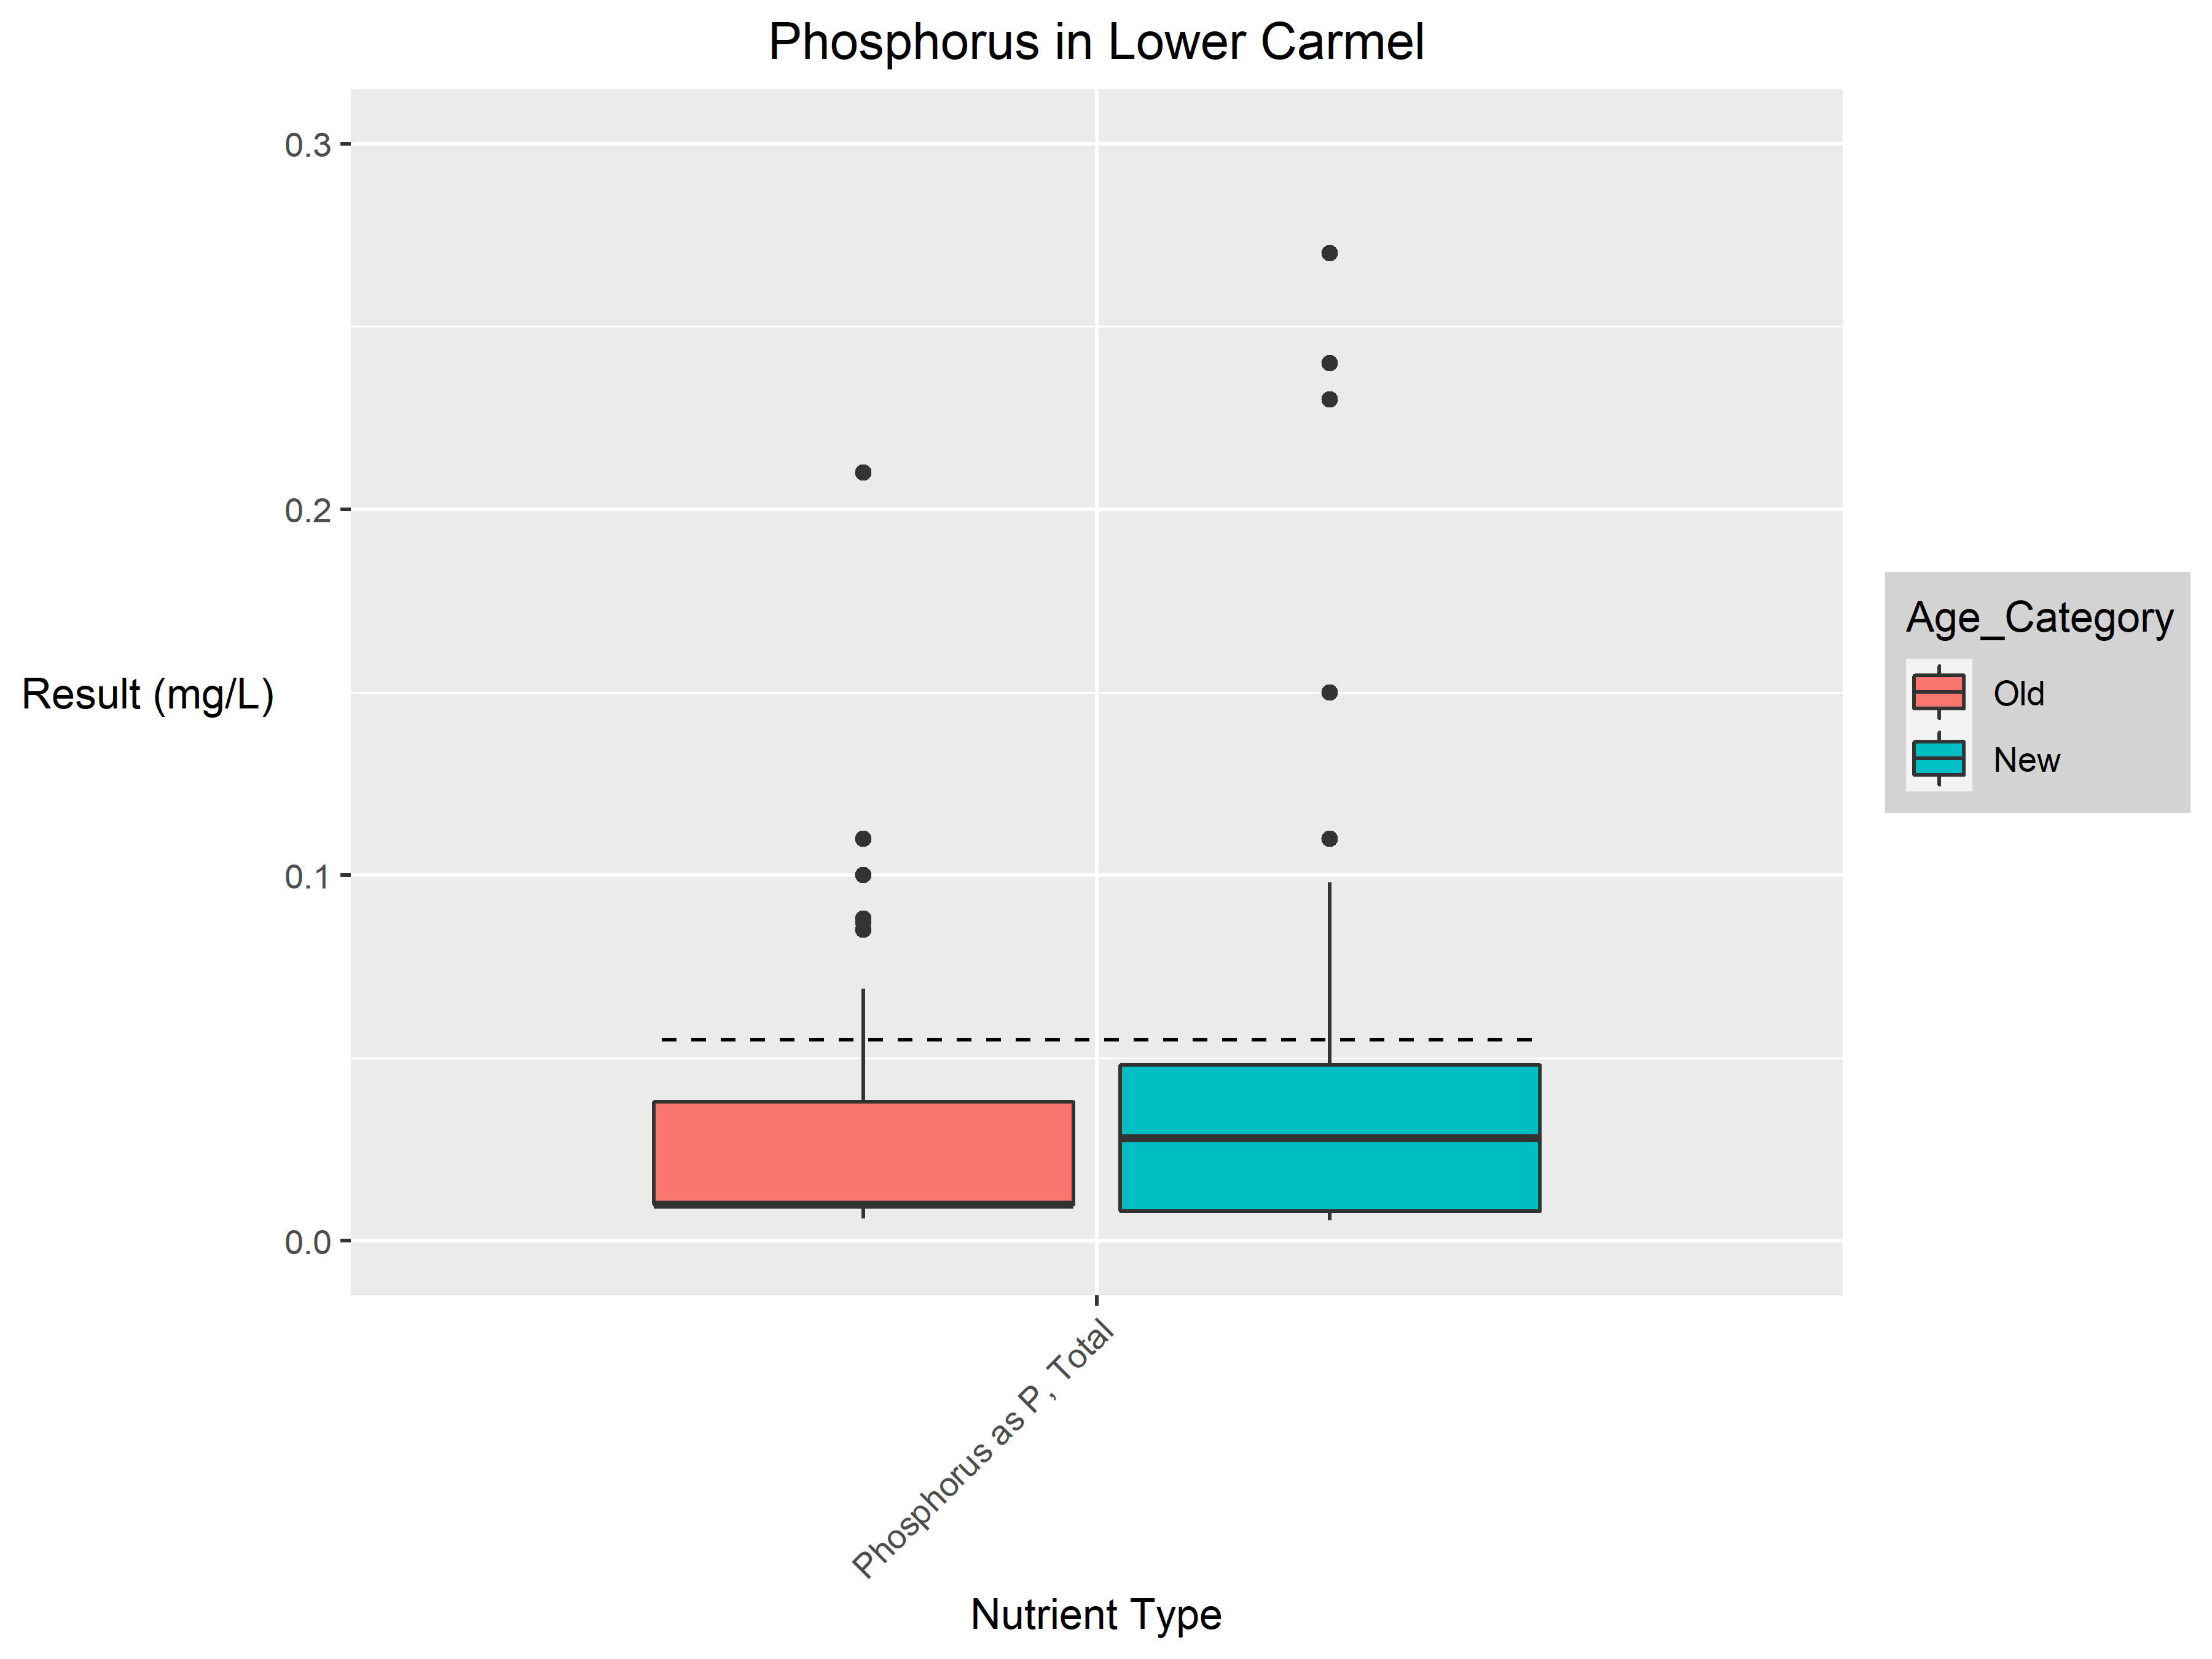
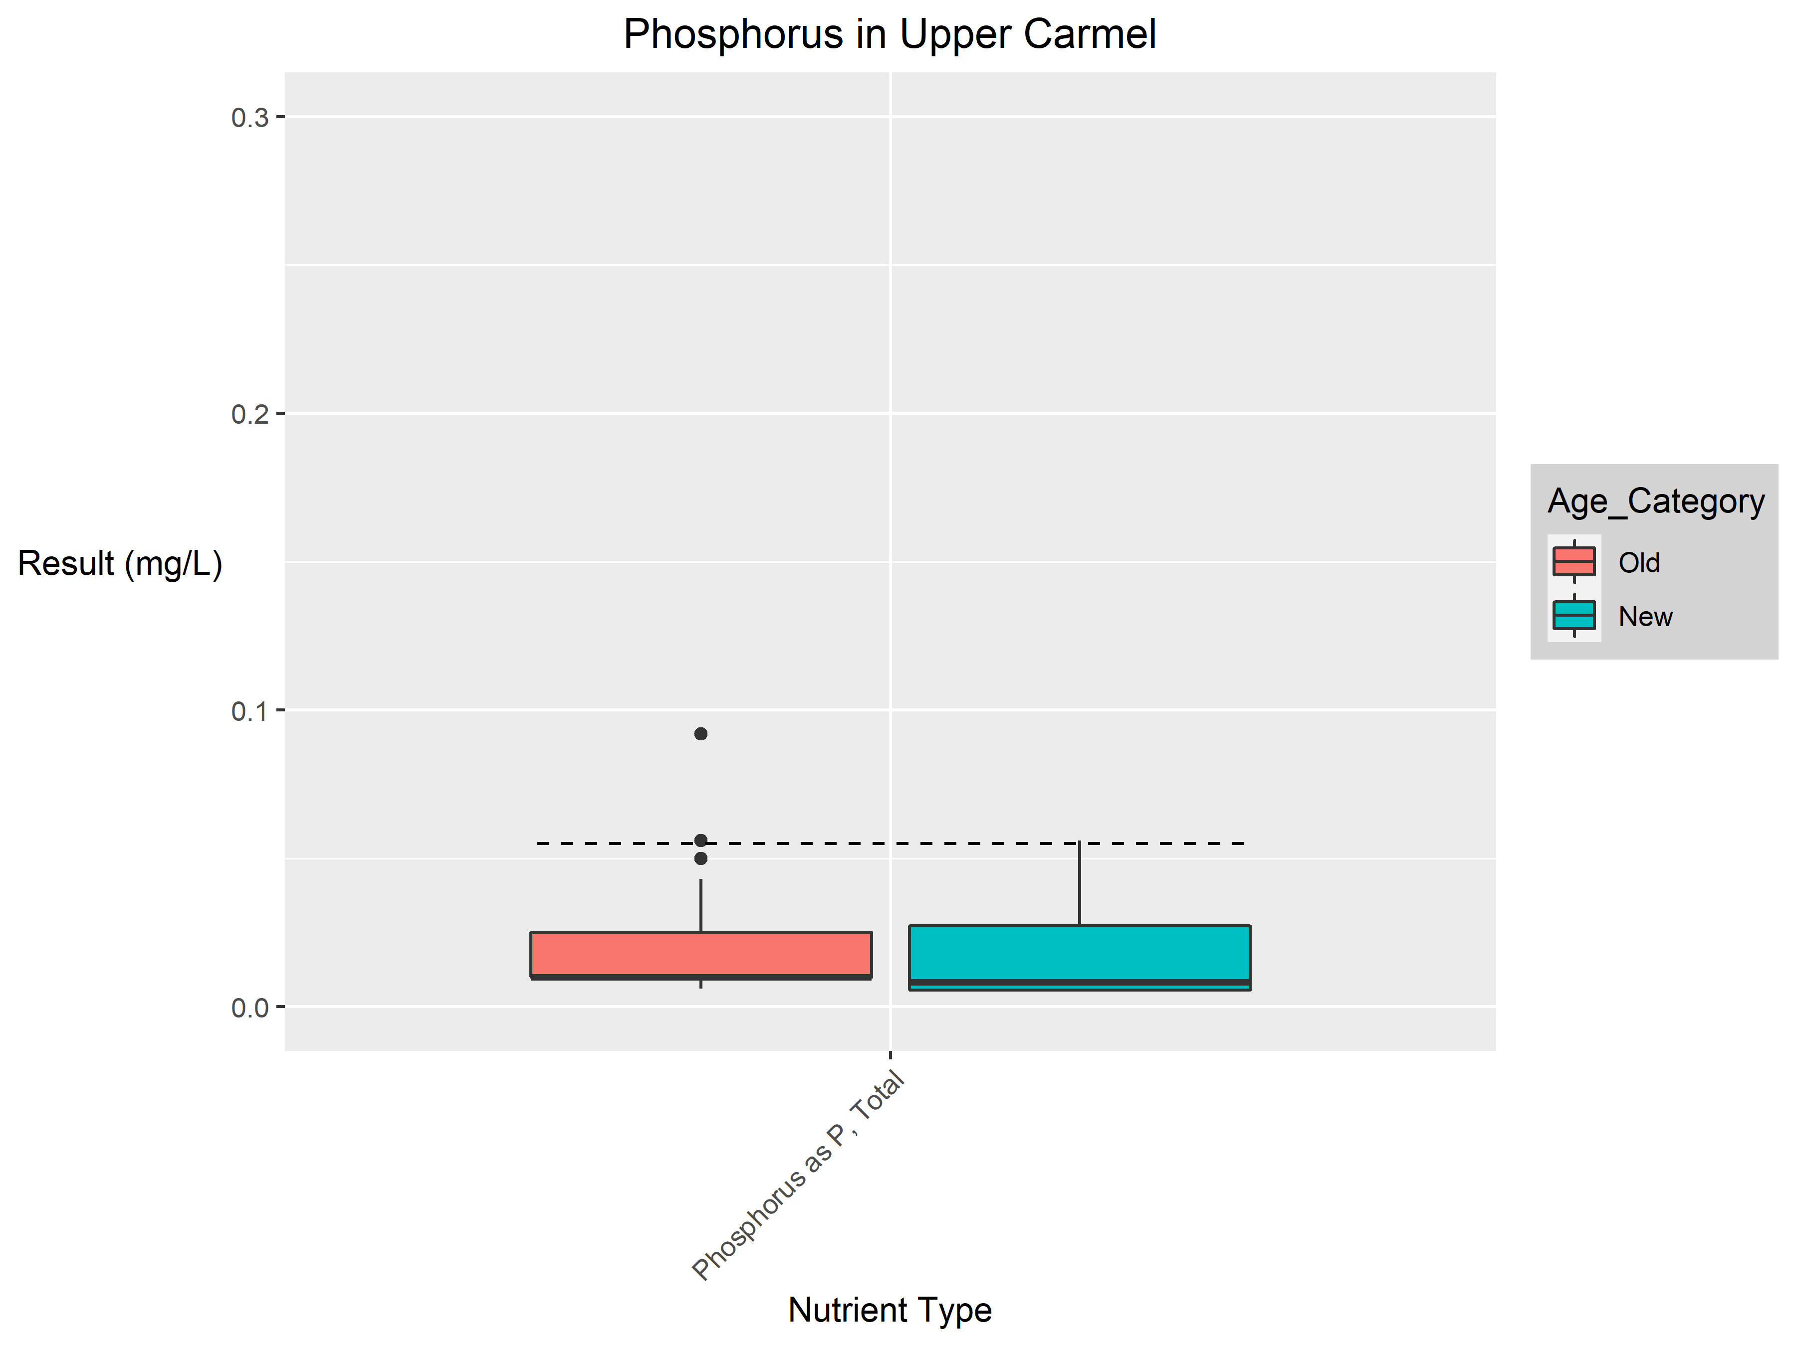
Phosphorus in Lower Carmel (Left) and upper Carmel (Right)
0.3
0.2
0.1
0.0
Result (mg/L)
0.055 mg/L
0.055 mg/L
Total Phosphorus
Notes:
P threshold (0.055 mg/L), of all the nutrient types Phosphorus has the most above the threshold the majority being in the lower Carmel portion

Slide 11
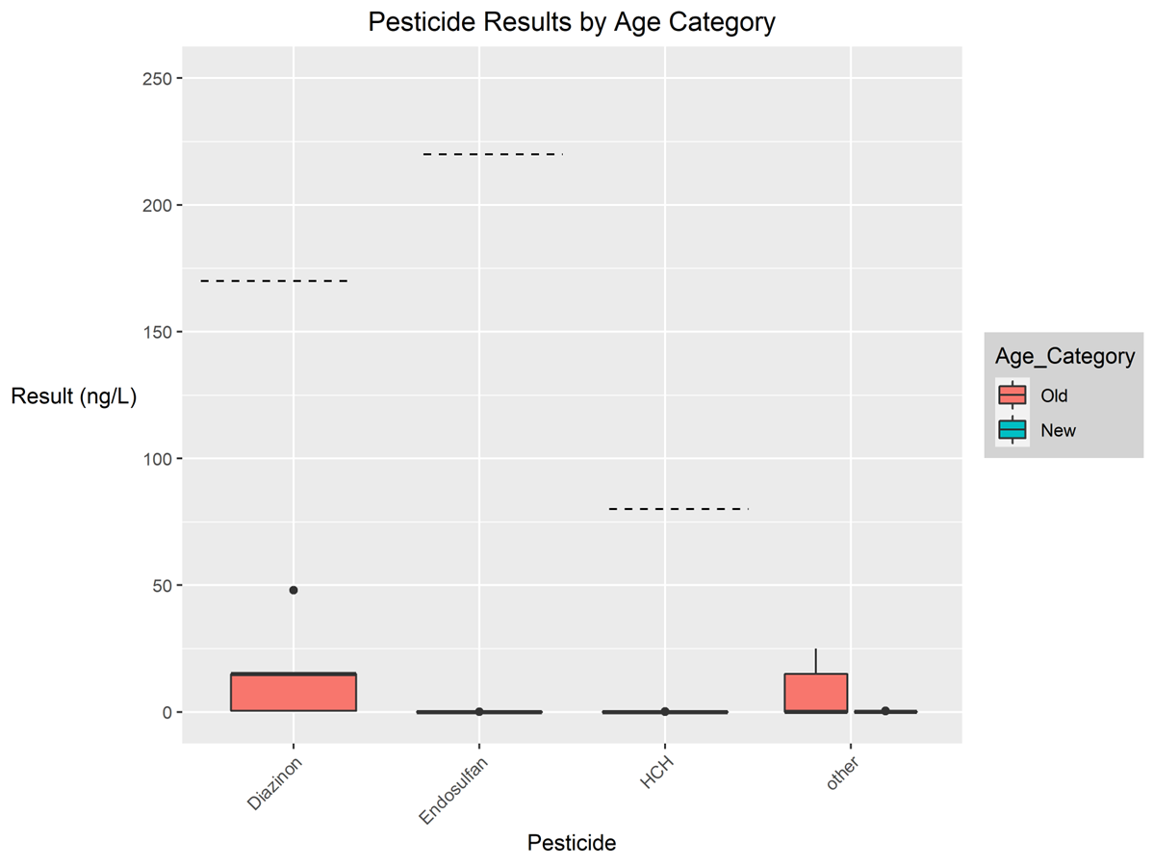
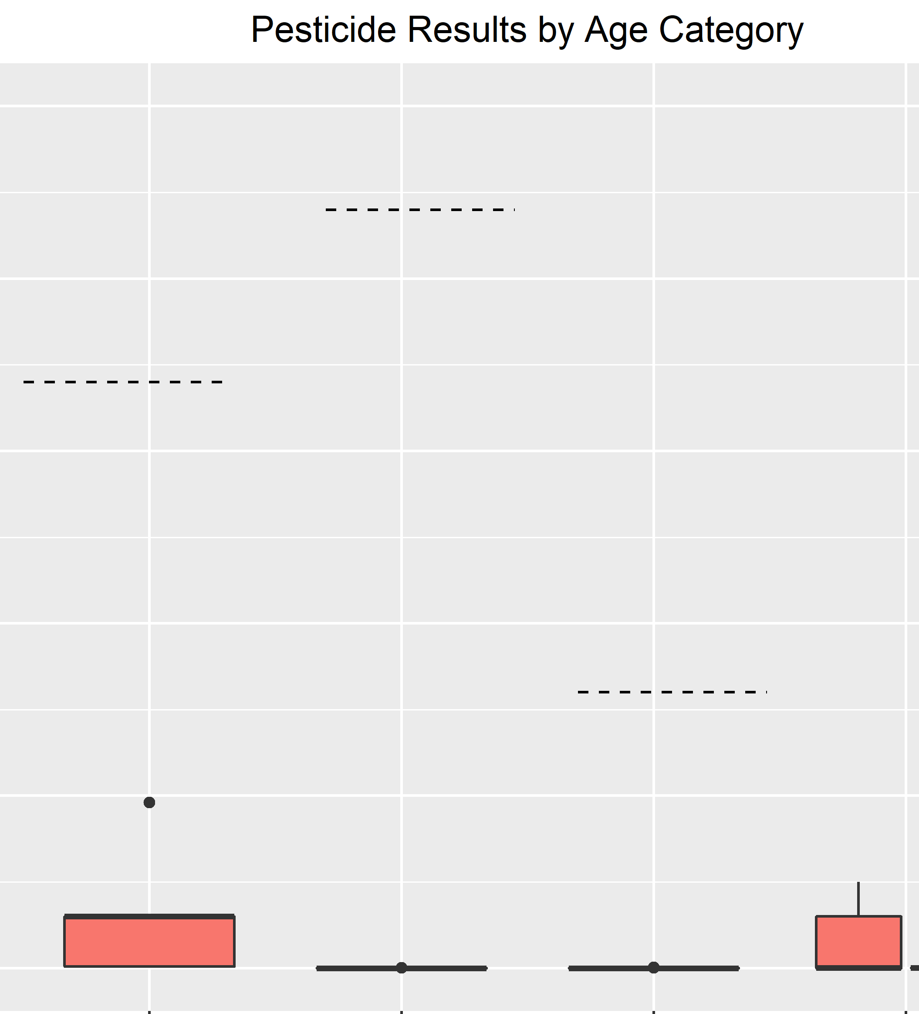
Old Pesticides within the Lower portion of the Carmel River Watershed
250
220 ng/L
200
170 ng/L
Result (ng/L)
150
Old
New
100
80 ng/L
50
0
Diazinon Endosulfan HCH Other
Pesticide Type
Notes:
Only old pesticides here no new ones, any of the other category that are above 1ng/L are what was deemed as actually below their thresholds, Diazinon threshold (170 ng/L), Endosulfan (220 ng/L), HCH (80 ng/L)

Slide 12
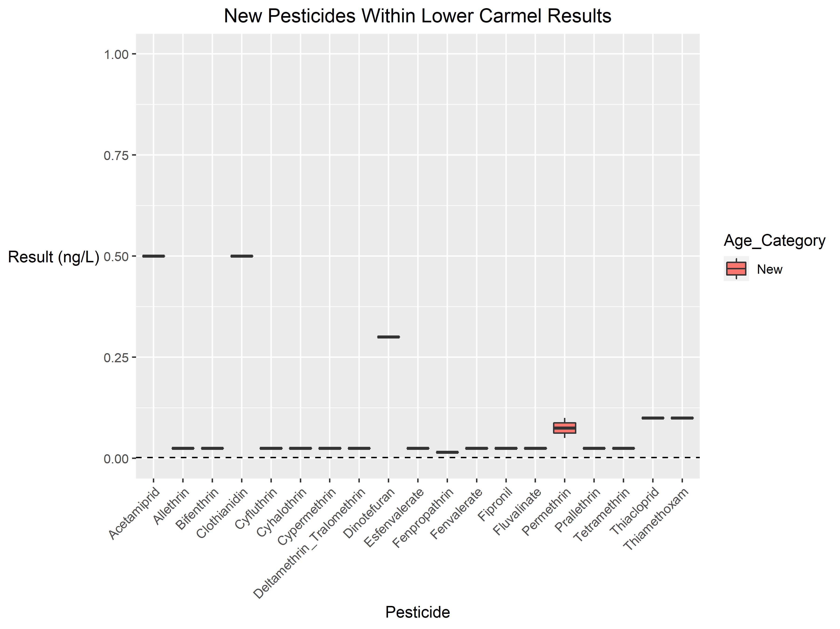
New Pesticides within the Lower portion of the Carmel River Watershed
Notes:
Only new pesticides, all new pesticides do not have set thresholds for freshwater systems within the past 40 yrs, we set the threshold as the MDL which was around 0.002 ng/L for each, most these pesticides only had one value besides Permethrin and Finopril

Slide 13
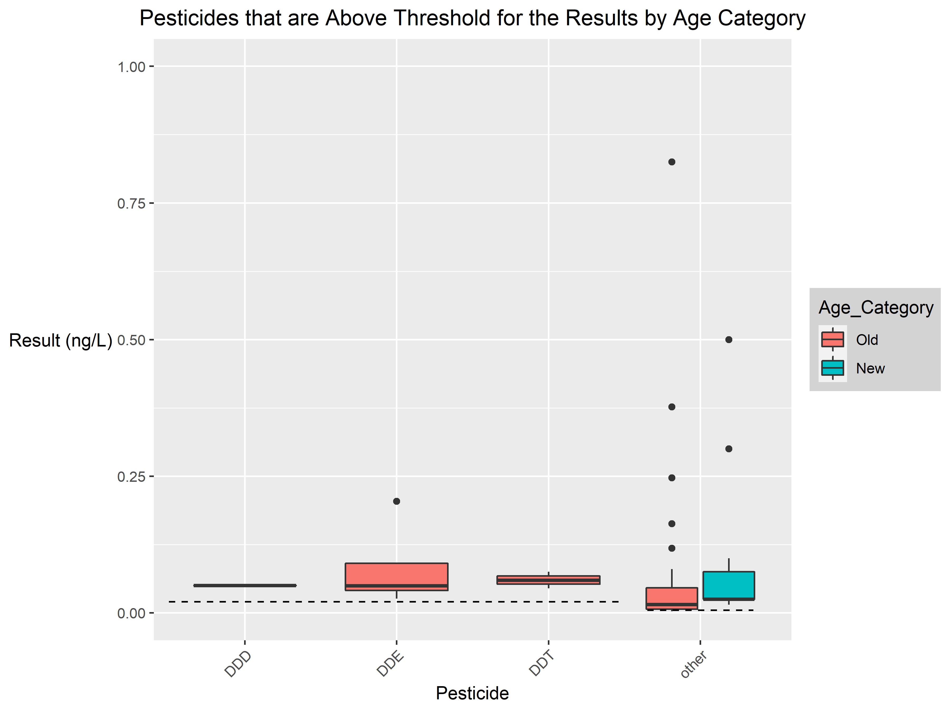
Pesticide Graph Above Threshold limit
Notes:
DDD, DDE, DDT threshold (0.02ng/L) are only within the older category, no new data on them, scale from 0-1, again all the new pesticides have a threshold around (0.002 ng/L) because these were set from MDL’s since the EPA has no new data on them. The main ones above the threshold are Dacthal, Fipronil, Hexachlorobenzene, Nonachlor, & Oxychlordane

Slide 14
Sources
State Water Resources Control Board (2022). CEDEN [database]. Date accessed: 11/02/2022.
Worcester K., Paradies D., & Hunt J. (2015). California Central Coast Healthy Watersheds Project- Part 1. Date accessed: 11/02/2022.

